Slide 1
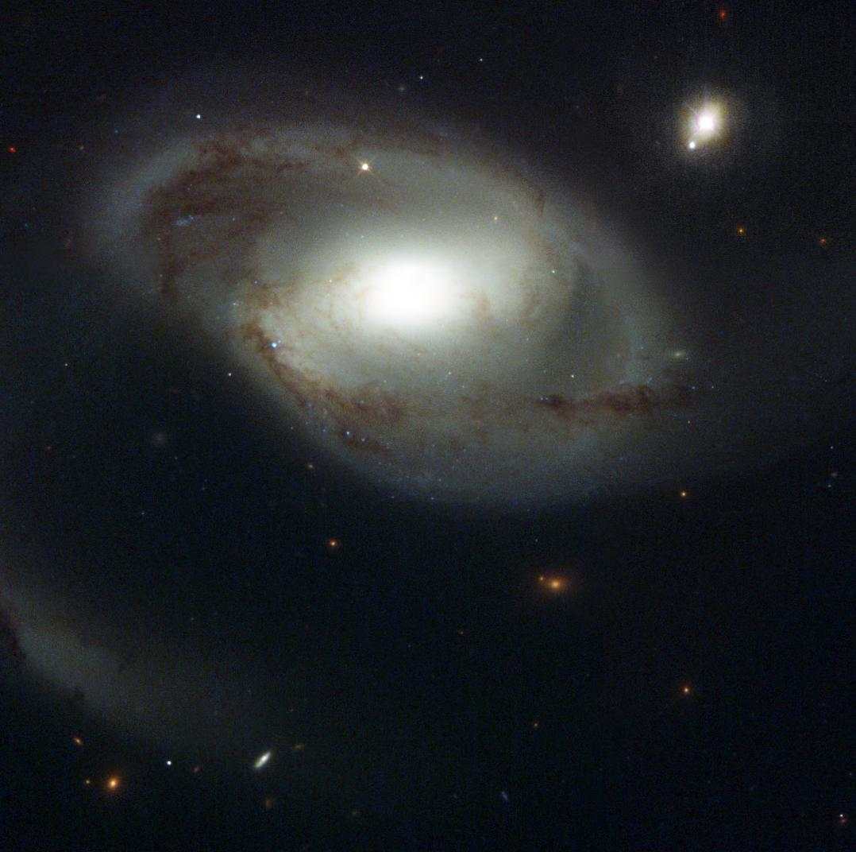
Does the gas in the IGM care about galaxies?
Tracing the Circumgalactic Medium in Lyα with COS
David M. French
AAS Dissertation Talk
University of Wisconsin - Madison
Thesis Advisor: Bart Wakker
Jan 11, 2018
Image Credit: NASA and The Hubble Heritage Team (STScI/AURA)

Slide 2
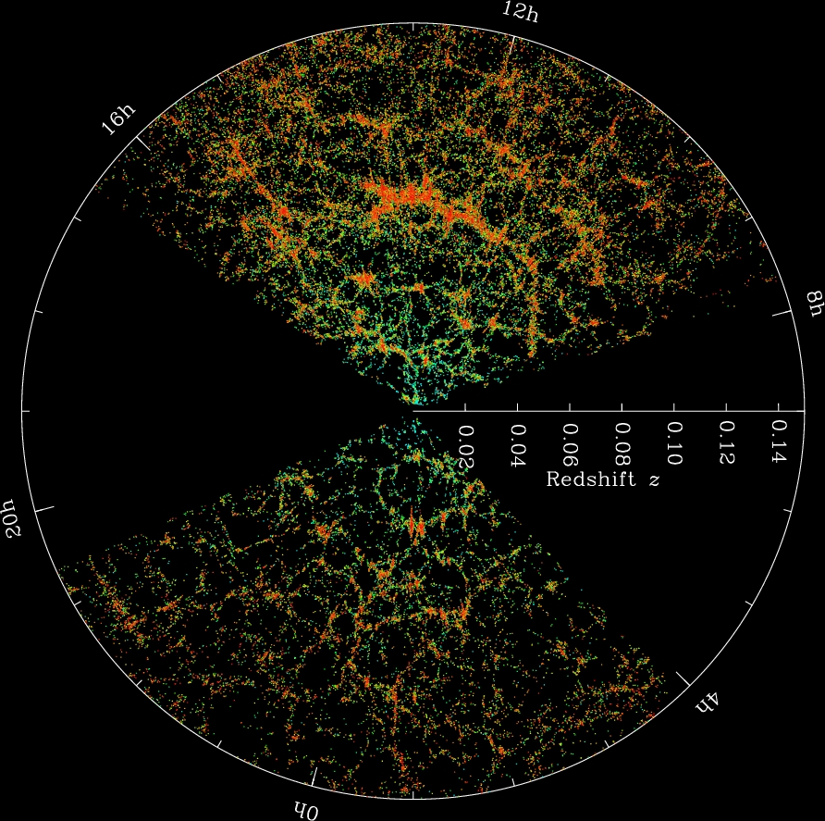
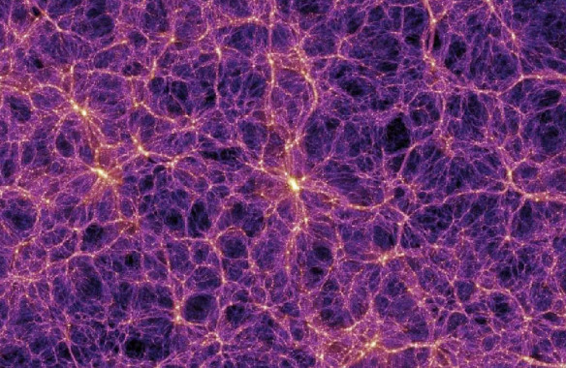
Gas + galaxies trace the same potential
The Millenium Simulation
SDSS Collaboration
Notes:
Gas collapsed with DM into filaments = cosmic web, formed galaxies

Slide 3
Does the gas care about the galaxies?
Gas and galaxies should follow the same DM potential
Galaxies need to continue accreting gas over cosmic time to match observations
Feedback kicks gas out of galaxies
How do the properties of halo gas correlate with nearby galaxy properties?

Slide 4
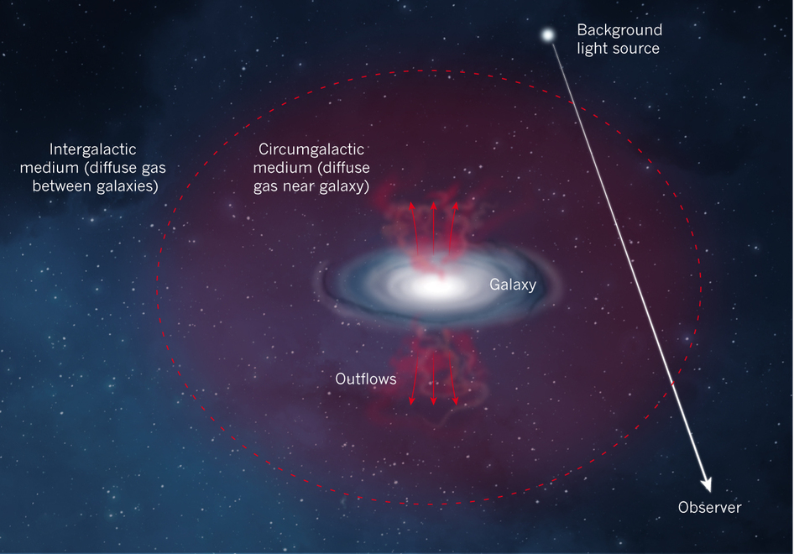
Probing the CGM with QSO absorption
Diffuse halo gas -> QSO absorption
Must rely on serendipitous QSO location
Build a sample of single galaxy-QSO pairs
Impact parameter and ΔV give absorber position
ΔV
Impact parameter (ρ)
Nature 517, 444
Notes:
Put one of these first

Slide 5
Science Outline
Use archival Cosmic Origins Spectrograph (COS) sightlines (~700)
Concentrating on Ly-alpha lines
Correlate with galaxy environment
Limit search to cz < 10,000 km/s
Ask
absorber(EW, velocity) vs galaxy properties (size, proximity, orientation)

Slide 6
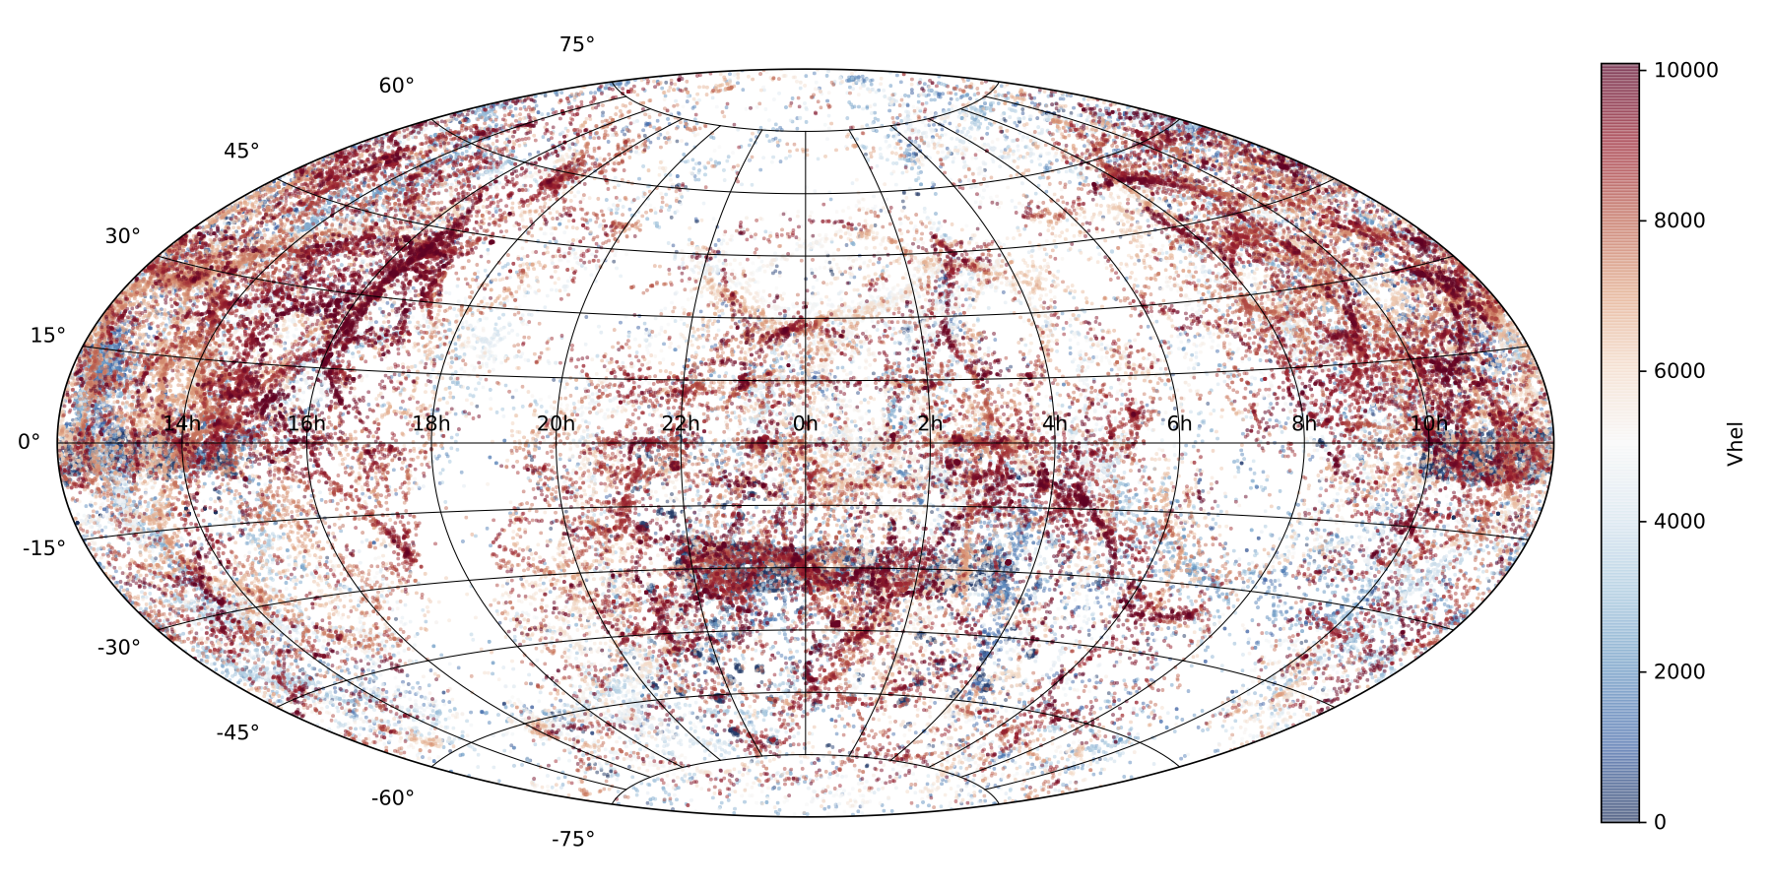
First – New Nearby Galaxy Catalog
Gather existing galaxy data
NED + IRSA
130,000+ galaxies with cz < 10,000 km/s
French & Wakker 2018, in prep

Slide 7
New Nearby Galaxy Catalog
Homogenize existing data
Normalize diameters, inclinations, PAs to 2MASS values
Choose representative magnitudes, calculate (L*, R_{vir})
French & Wakker 2018, in prep

Slide 8
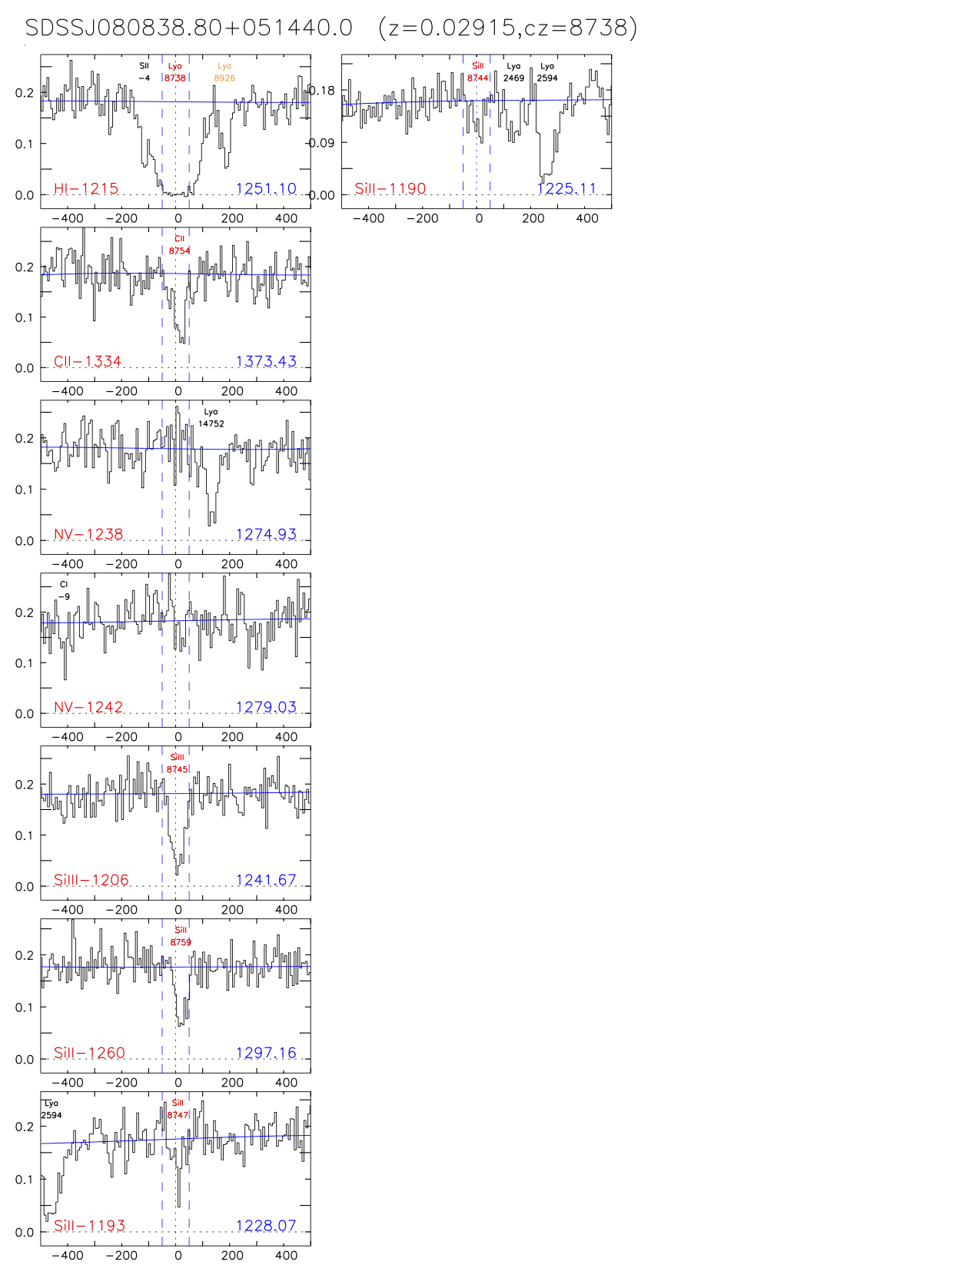
Catalog the absorbers
700+ G130M COS targets
Align, identify and measure all lines
Produce a catalog of fit parameters
French & Wakker 2018, in prep

Slide 9
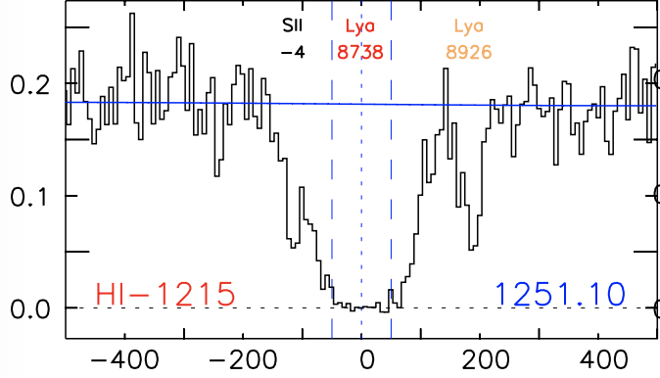
Catalog the absorbers
Concentrate on Ly-alpha
Correlate with galaxy environment
French & Wakker 2018, in prep

Slide 10
Catalog the absorbers
Connecting with galaxies – using our galaxy catalog
Which one?
French & Wakker 2018, in prep

Slide 11
Matching absorbers with galaxies
Define an objective likelihood parameter
Define a likelihood:
= impact parameter
= viral radius of the galaxy

Slide 12
Matching absorbers with galaxies
Applying the likelihood method
Set criteria
= 0.00027
= 0.16
French & Wakker 2018, in prep

Slide 13
Model sightline velocity structure
What does the sightline “see”?
Is there a Halo – disk kinematic connection?
CGCG039-137 : vhel = 6918 km/s
French & Wakker 2018, in prep
French & Wakker 2018, in prep

Slide 14
Model sightline velocity structure
Is there a Halo – disk kinematic connection?
CGCG039-137 : vhel = 6918 km/s
French & Wakker 2018, in prep
French & Wakker 2018, in prep

Slide 15
Model sightline velocity structure
The halo – disk kinematic connection
H-alpha rotation curves from SALT
French & Wakker 2018, in prep

Slide 16
Model sightline velocity structure
The halo – disk kinematic connection
Model the sightline velocity
CGCG039-137 : vhel = 6918 km/s
French & Wakker 2018, in prep
French & Wakker 2018, in prep

Slide 17
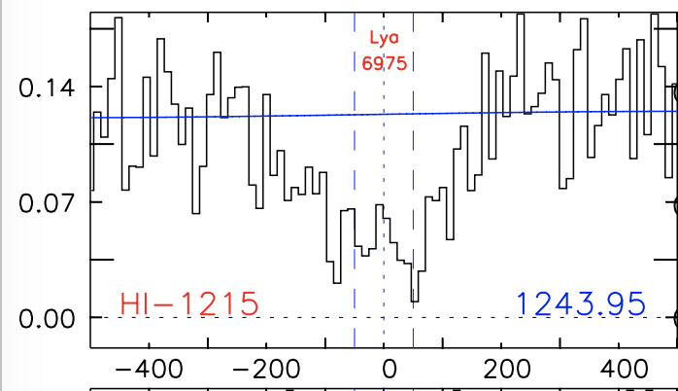
Model sightline velocity structure
The halo – disk kinematic connection
Model the sightline velocity
CGCG039-137 : vhel = 6918 km/s
dv = 57 km/s
dv = 57 km/s
French & Wakker 2018, in prep
French & Wakker 2018, in prep

Slide 18
Preliminary Results
Status:
237 spectra aligned and identified
1067 Ly-alpha absorbers
331 measured
116 ”associated” with a single galaxy using our likelihood method
French & Wakker 2018, in prep

Slide 19
Preliminary Results
EW vs impact parameter:
French & Wakker 2017
French & Wakker 2017

Slide 20
Preliminary Results
EW vs velocity separation:
Blueward of galaxy
systemic velocity
Blueward of galaxy
systemic velocity
French & Wakker 2017

Slide 21
Preliminary Results
Inclinations:
French & Wakker 2017
French & Wakker 2017

Slide 22
Inclination overabundance
Evidence of non-spherical halo?
Covering fraction of Ly-alpha < 1
French & Wakker 2017

Slide 23
Summary:
700+ COS spectra correlated with 130,000+ galaxies
Expect ~3000 Ly-alpha absorbers
~1000 absorber-galaxy pairs using likelihood method
Strong EW – ΔV correlation
Overabundance around highly inclined galaxies
Disk-halo kinematic connection?
Probably not very far reaching, stay tuned.
Does CGM gas care about galaxies?
It seems like it might!
French & Wakker 2017

Slide 24
New Nearby Galaxy Catalog
Homogenize existing data
Normalize diameters, inclination, PA to 2MASS values
Choose magnitudes, calculate (L*, R_{vir})
Magnitude – Diameter Relation
French & Wakker 2018, in prep

